Slide 1

CUI Abbottabad
Department of Computer Science
SRE
2
Fundamentals of RE

Slide 2
Outline
Fundamentals of SRE
Requirements definition
Types of Requirement

Slide 3
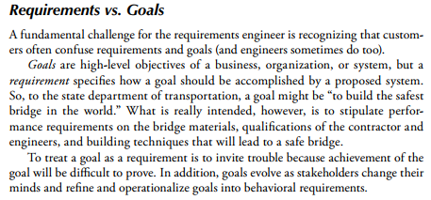

Slide 4
Fundamental of sre

Slide 5
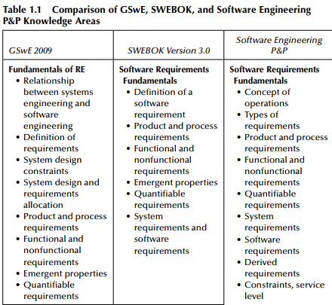

Slide 6
Requirements Traceability:
Establish traceability links between requirements and other artifacts in the development process, such as design documents, test cases, and code. This helps in ensuring that each requirement is satisfied and that changes are properly managed.
Change Management:
Implement a change control process to manage and track changes to requirements. Changes should be carefully evaluated and documented to prevent scope creep.
Communication and Collaboration:
Effective communication among team members, stakeholders, and users is crucial. Collaboration tools and techniques like workshops and reviews can facilitate this process.
Documentation and Documentation Management:
Maintain accurate and up-to-date documentation throughout the software development lifecycle. This includes version control and configuration management for requirements documents.
Validation and Verification:
Validate the requirements with stakeholders to ensure they accurately reflect their needs. Verification involves checking whether the requirements are complete, consistent, and traceable.
Requirements Prioritization:
Prioritize requirements based on business value, risk, and dependencies. This helps in making informed decisions during project planning and implementation.

Slide 7
Change Management:
Implement a change control process to manage and track changes to requirements. Changes should be carefully evaluated and documented to prevent scope creep.
Communication and Collaboration:
Effective communication among team members, stakeholders, and users is crucial. Collaboration tools and techniques like workshops and reviews can facilitate this process.
Documentation and Documentation Management:
Maintain accurate and up-to-date documentation throughout the software development lifecycle. This includes version control and configuration management for requirements documents.
Validation and Verification:
Validate the requirements with stakeholders to ensure they accurately reflect their needs. Verification involves checking whether the requirements are complete, consistent, and traceable.
Requirements Prioritization:
Prioritize requirements based on business value, risk, and dependencies. This helps in making informed decisions during project planning and implementation.
Traceability and Impact Analysis:
Establish traceability between requirements and other artifacts (e.g., design, code, test cases) to track the impact of changes and ensure all requirements are met.

Slide 8
Risk Management:
Identify potential risks related to requirements and develop strategies to mitigate them. This includes addressing uncertainties, changing priorities, and evolving stakeholder needs.
Prototyping and Mockups:
Use prototypes and mockups to provide stakeholders with a visual representation of the system, helping to refine and validate requirements.
User Acceptance Testing (UAT):
Involve end-users in UAT to ensure that the final software meets their expectations and needs.
Documentation Review:
Regularly review and update the requirements documentation to reflect changing project conditions and stakeholder feedback.
Continuous Improvement:
Continuously improve the requirements engineering process based on lessons learned from previous projects.

Slide 9
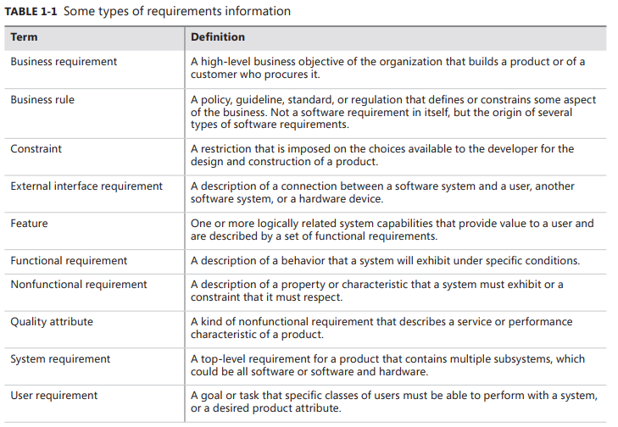

Slide 10
Business requirements
describe why the organization is implementing the system—the business benefits the organization hopes to achieve. The focus is on the business objectives of the organization or the customer who requests the system. Suppose an airline wants to reduce airport counter staff costs by 25 percent. This goal might lead to the idea of building a kiosk that passengers can use to check in for their flights at the airport. Business requirements typically come from the funding sponsor for a project, the acquiring customer, the manager of the actual users, the marketing department, or a product visionary. We like to record the business requirements in a vision and scope document. Other strategic guiding documents sometimes used for this purpose include a project charter, business case, and market (or marketing) requirements document.

Slide 11
Business rules include corporate policies, government regulations, industry standards, and computational algorithms, business rules are not themselves software requirements because they have an existence beyond the boundaries of any specific software application. However, they often dictate that the system must contain functionality to comply with the pertinent rules. Sometimes, as with corporate security policies, business rules are the origin of specific quality attributes that are then implemented in functionality. Therefore, you can trace the genesis of certain functional requirements back to a particular business rule.

Slide 12
User requirements describe goals or tasks the users must be able to perform with the product that will provide value to someone. The domain of user requirements also includes descriptions of product attributes or characteristics that are important to user satisfaction. Ways to represent user requirements include use cases (Kulak and Guiney 2004), user stories (Cohn 2004), and event-response tables. Ideally, actual user representatives will provide this information. User requirements describe what the user will be able to do with the system.
An example of a use case is “Check in for a flight” using an airline’s website or a kiosk at the airport. Written as a user story, the same user requirement might read: “As a passenger, I want to check in for a flight so I can board my airplane.” It’s important to remember that most projects have multiple user classes, as well as other stakeholders whose needs also must be elicited.

Slide 13
Functional requirements specify the behaviors the product will exhibit under specific conditions. They describe what the developers must implement to enable users to accomplish their tasks (user requirements), thereby satisfying the business requirements. This alignment among the three levels of requirements is essential for project success. Functional requirements often are written in the form of the traditional “shall” statements: “The Passenger shall be able to print boarding passes for all flight segments for which he has checked in” or “If the Passenger’s profile does not indicate a seating preference, the reservation system shall assign a seat.
Nonfunctional requirements address the environment in which the system operates, such as platform, portability, compatibility, and constraints. Many products are also affected by compliance, regulatory, and certification requirements. There could be localization requirements for products that must take into account the cultures, languages, laws, currencies, terminology, spelling, and other characteristics of users.

Slide 14
Software requirements include three distinct levels: business requirements, user requirements, and functional requirements. In addition, every system has an assortment of nonfunctional requirements. The model in Figure 1-1 illustrates a way to think about these diverse types of requirements.
The ovals in Figure 1-1 represent types of requirements information, and the rectangles indicate documents in which to store that information. The solid arrows indicate that a certain type of information typically is stored in the indicated document. (Business rules and system requirements are stored separately from software requirements, such as in a business rules catalog or a system requirements specification, respectively.) The dotted arrows indicate that one type of information is the origin of or influences another type of requirement. Data requirements are not shown explicitly in this diagram. Functions manipulate data, so data requirements can appear throughout the three levels.

Slide 15
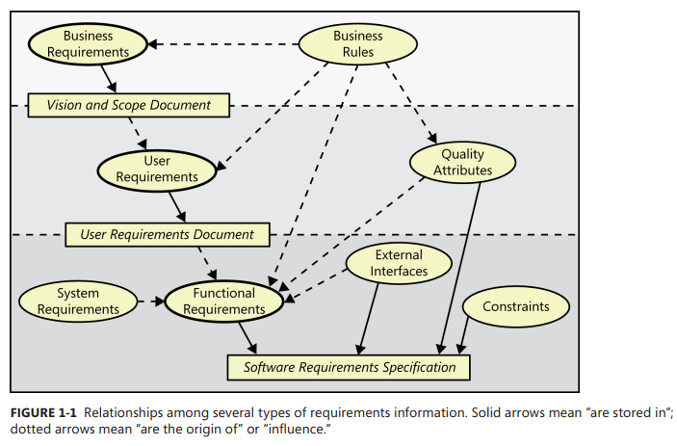

Slide 16
